Slide 1
Data Authentication : SDA/DDA/CDA
Data Authentication in the context of EMV (Europay, MasterCard, and Visa) refers to the methods used to verify the authenticity and integrity of the data stored on the EMV chip card during a transaction. These methods help prevent counterfeit card fraud and ensure that the card being used is genuine. There are three main types of Data Authentication used in EMV:
SDA
DDA
CDA

Slide 2
Static Data Authentication (SDA)
SDA is a basic form of data authentication. It involves a digital signature that is generated by the card issuer and stored on the card's chip during the card personalization process. This signature is based on static data elements such as the cardholder's account number, expiration date, and other non-changing card information. During a transaction, the terminal sends a challenge to the card's chip, and the chip uses the stored signature to verify the authenticity of the data.
Comparison: Least secure among three, uses a static signature based on non-changing card data.

Slide 3
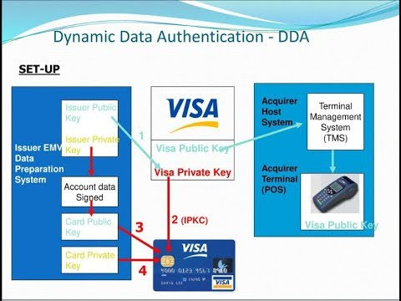
Dynamic Data Authentication (DDA)
DDA is a more advanced form of data authentication. It uses a cryptographic process to create a unique digital signature for each transaction. The signature is based on dynamic data elements that change with each transaction, such as a transaction counter or a random number generated by the terminal. The terminal and the card chip collaborate to create and verify this dynamic signature.
comparison: More secure than SDA, generates a dynamic signature for each transaction based on changing data elements.

Slide 4
Combined Data Authentication (CDA)
CDA combines elements of both SDA and DDA. It uses dynamic data elements like DDA to create a unique transaction-specific signature, but it also includes a component of the static signature used in SDA. This makes CDA more resilient against certain types of attacks, as it combines the strengths of both static and dynamic authentication methods.
comparison: Most secure among the three, combines dynamic and static data elements for a robust authentication process.

